Slide 1
Limited Feature Fraud-Detection DNNs Using Sigmoid & Leaky ReLu
Liam R. Watson

Slide 2
Business Needs: a difficult balance
As mentioned at the opening meeting, the most effective way of preventing fraud is a clean sweep – decline all transactions.
Practically this is of course not feasible – we need accurate detections in place, but also avoid customer dissatisfaction.
Growth always presents bad actors, and the last years have seen a rapidly growing number of fraud cases – countermeasures need to be more effective.
What’s the solution to this careful balance?
Well, here we explore one axis of addressing this: Deep Neural Networks (DNN’s).
There are, as you’ll know, drawbacks to this method, including speed constraints.

Slide 3
Data Specifics
Based on best recommendations from research papers (see end of slides), the feature set provided was slimmed down to 40 input parameters in order to achieve high-accuracy/low data fuzziness, as well as fast predictions – we need this system to be production ready.
Included in this feature set are all FLAG headers, COUNT 7DAY headers, and AMOUNT
Data exploration using test DNN’s showed that AVAIL_CRDT and CREDIT_LIMIT had bearing on FRAUD probabilities, but that the same could be derived from other features selected – so these 2 were left out.

Slide 4
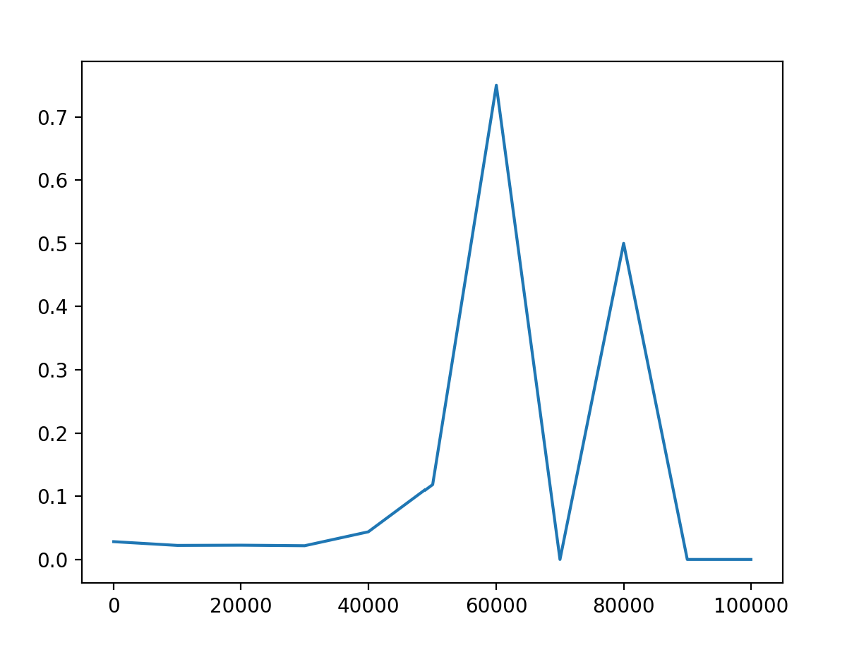
Data Specifics (continued)

Slide 5
Technical Specifics
Various pre-built libraries were considered for this solution, but the decision came down to using an in-house developed (June 2020-Present) library written in C & Python.
The needs of this problem are low-level enough that I wanted to be able to tinker with the fundamentals, including adaptive learning rates and over-training detection.
The library supports any conventional NN topology and popular activation functions (Leaky ReLu, Sigmoid, HypTan etc.) as well as any number of layers

Slide 6
Technical Specifics (continued)
Using the data parameters specified before, the following configuration was used:
40 input values – each of the headers
1 bias for each layer (of course!)
4 hidden layers varying in size from 18 to 36 (bubble topology)
2 output values – probabilities of NOT FRAUD and FRAUD respectively
i.e. 0.9,0 means NOT FRAUD, 0,0.7 means FRAUD
The submission PREDICTION values were generated by taking the max of the output values, and the PROBABILITY values were generated by taking the absolute difference between them

Slide 7
Technical Accuracy
The DNN achieved 60%-80% accuracy in predicting actual FRAUD cases, while it managed to only inaccurately predict FRAUD in non-FRAUD cases 5%-8% of the time!
Accuracy is of course extremely important, and the balance mentioned earlier is likewise critical to running a business, so the confidence level before declining a transaction was and can be adjusted as needed to reduce the 5%-8% to 1% or low – of course it risks letting some FRAUD through.
Further training, especially on GPU’s, would likely immensely increase accuracy.

Slide 8
Final Thoughts
Clearly DNN’s can get the job done, so now it’s a matter of optimization input & output parameters, hyperparameters, hardware etc. to achieve the best results.
At the same time, DNN’s are so-called black boxes – they are not easily explainable.
For this reason I provide an alternate methodology using Formal Concept Lattices (FCL’s), which is in my field of hobby studies.
Using FCL’s, we can condense the data into a matrix and then represent it using clear, explainable implications/associations, which allow for some safety from corporate scrutiny as a business, and rune extremely fast.

Slide 9
References
Dornadula, Vaishnavi Nath, and S Geetha. “Credit Card Fraud Detection Using Machine Learning Algorithms.” Procedia Computer Science, vol. 165, 2019, pp. 631–641., https://doi.org/10.1016/j.procs.2020.01.057.
S P, Maniraj & Saini, Aditya & Ahmed, Shadab & Sarkar, Swarna. (2019). Credit Card Fraud Detection using Machine Learning and Data Science. International Journal of Engineering Research and. 08. 10.17577/IJERTV8IS090031.

